Slide 1
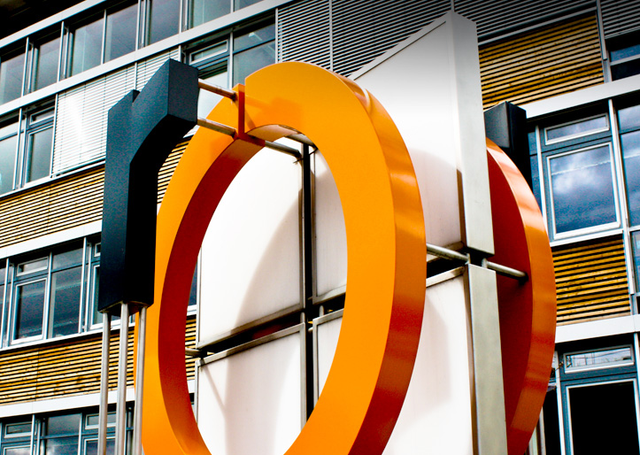



Slide 2

On your marks, get set, go…
Degree starter programme summer semester 2024
„Personal responsibility in your studies“
Notes:
2

Slide 3
Task:
Decide for yourself and spontaneously whether you agree or disagree to each of the following statements.
Note your answers.
Notes:
3

Slide 4
Statement 1
I always need to take notes in lectures.
A) AGREE B) DISAGREE
Statement 2
I only go to events I am interested in.
A) AGREE B) DISAGREE
Notes:
4

Slide 5
Statement 3
Building up a social network is important when studying.
A) AGREE B) DISAGREE
Statement 4
If I don’t pass an exam I’m not bothered, I’ll just take it again next time.
A) AGREE B) DISAGREE
Notes:
5

Slide 6
Statement 5
I should always do my homework.
AGREE B) DISAGREE
Statement 6
I have lots of free time now that I am a student.
A) AGREE B) DISAGREE
Notes:
6

Slide 7
Statement 7
I study best throughout the semester and not right before the exams.
A) AGREE B) DISAGREE
Statement 8
I am all on my own when my studies aren’t going well or I have problems organising my studies.
A) AGREE B) DISAGREE
Notes:
7

Slide 8
Statement 9
I should be as well dressed for an online lecture as I would be for a lecture in person.
AGREE B) DISAGREE
Statement 10
Online teaching gives me more free time.
A) AGREE B) DISAGREE
Notes:
8

